Slide 1
The History of the IOBC Global Working Group- Mass Rearing and Quality Assurance
Norm Leppla for
Patrick De Clercq & Thomas A. Coudron
Co-convenors MRQA
Workshop on Breeding and Quality Control of Entomophagous Insects and Entomopathogenic Fungi
Merida, Mexico
November 14 – 17, 2017
IOBC/MRQA

Slide 2
IOBC is an Advocate for the Biological Control Community
Established in 1995
Coordinates biocontrol activities worldwide
Promotes development and application of biological control
Assists in communication within the biocontrol community, but also with policy makers, regulators and the general public
Disseminates information via conferences, scientific journals ("BioControl", Springer), newsletters and websites (www.iobc-global.org)
Is subdivided in 6 regional sections
IOBC/MRQA

Slide 3
MISSION STATEMENT OF MRQA
The purpose of the IOBC Global Working Group on Mass Rearing and Quality Assurance (MRQA):
“To facilitate and advance cost effective rearing of high quality arthropods and other invertebrates that perform as specified in support of biological control and integrated pest management”
« Making them work in the field »
IOBC/MRQA

Slide 4
Field Application Excursion Cali, Colombia 1998
IOBC/MRQA

Slide 5
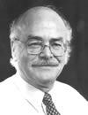
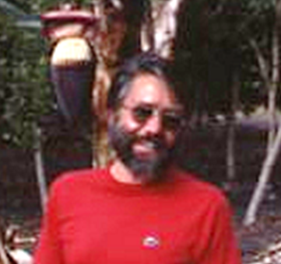
Develop QC for Mass Rearing Insects
1970s: Ernst Boller and Derrell Chambers organized symposia and training courses, with main focus on quality control for fruitfly production.
IOBC/MRQA

Slide 6
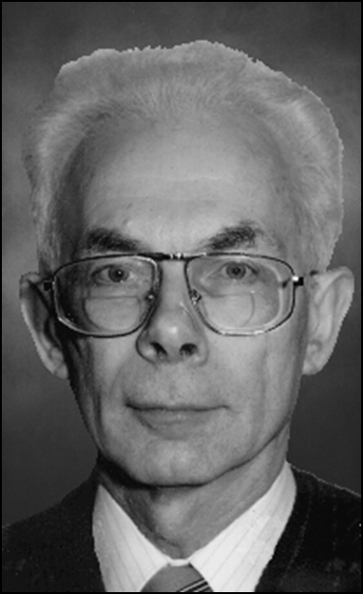
Develop QC for Mass Rearing Insects
1972- Ernst Boller, Behavioral aspects of mass rearing of insects,
Entomophaga, Ernst Boller 17:9-25.
1972- Manfred MacKauer, Genetic aspects of insect production. Entomophaga. 17:27-48.
IOBC/MRQA

Slide 7
Develop QC for Mass
Rearing Insects
1976- XX International Congress of Entomology “Characterization and Evaluation of Insect Colonies” Boller, Chambers, Leppla
1977- Derrell Chambers, Quality control in mass rearing, Annual Review Entomology. 22:289-308. WGQC (AMRQC)
IOBC/MRQA

Slide 8
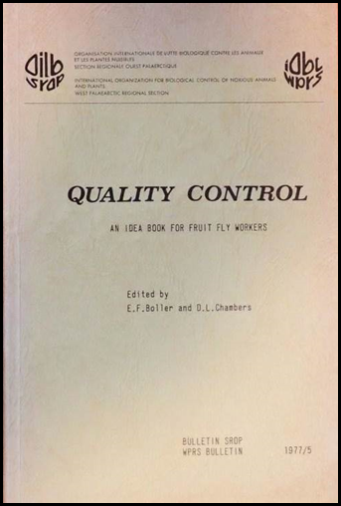
Develop QC for Mass Rearing Insects
1977: Quality Control, an Idea
Book for Fruit Fly Workers.
Boller & Chambers (eds.)
(www.amrqc.org)
1980: Established IOBC, WGQC
(AMRQC, MRQA)
1982: first workshop of WGQC in Gainesville, FL: emphasis on mass rearing for SIT
IOBC/MRQA

Slide 9
A BRIEF HISTORY OF THE GROUP
1991: 5th workshop of WGQC in Wageningen, The Netherlands: under the guidance of Joop van Lenteren and Franz Bigler emphasis shifted towards the development of quality control guidelines for natural enemies
1998: WGQC was combined with a newly formed group on artificial rearing of entomophagous insects and renamed the Arthropod Mass Rearing and Quality Control (AMRQC) working group
IOBC/MRQA

Slide 10
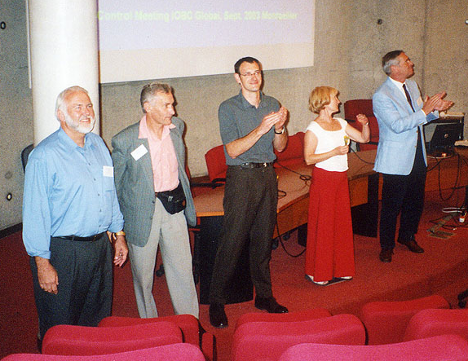
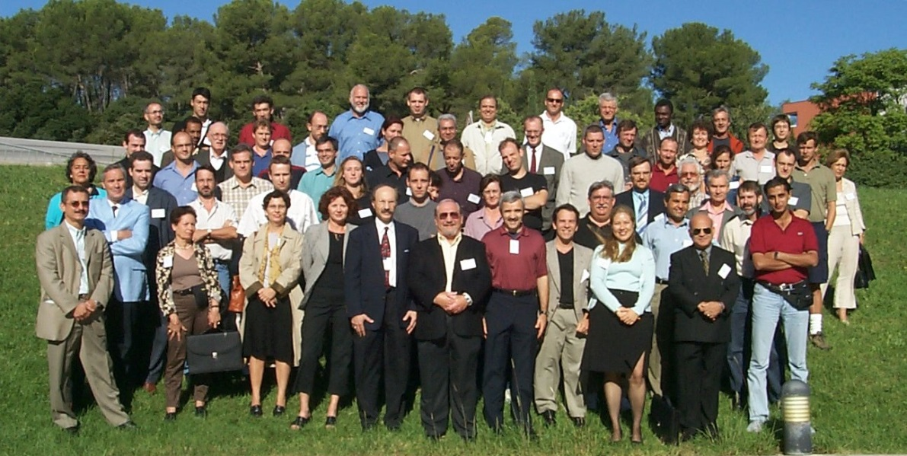
A BRIEF HISTORY OF THE GROUP
2003: 10th workshop of AMRQC in Montpellier, France: attention shifts back to quality control and rearing of entomophagous, haematophagous, as well as phytophagous arthropods
IOBC/MRQA

Slide 11
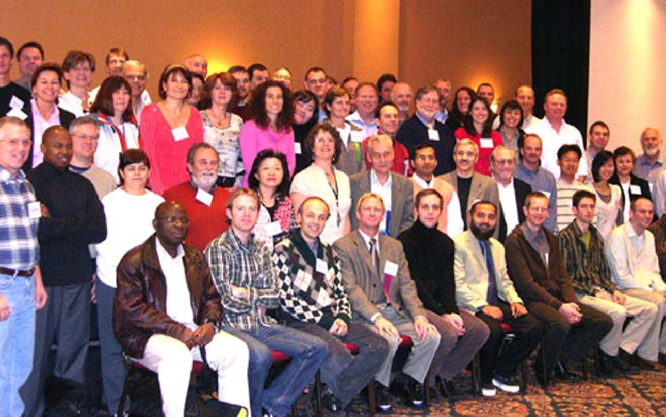
A BRIEF HISTORY OF THE GROUP
2007: 11th workshop of AMRQC in Montreal, Canada: focus was extended to include nematodes
IOBC/MRQA

Slide 12
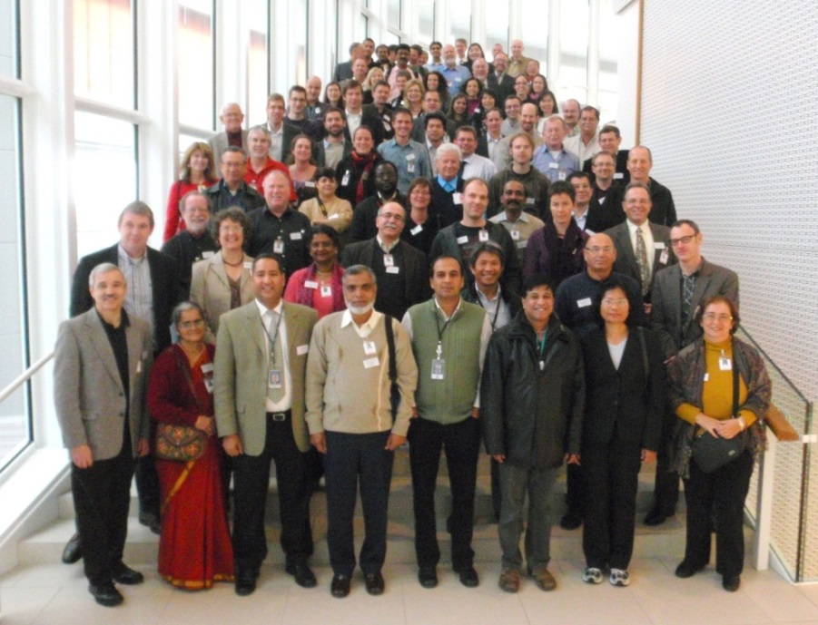
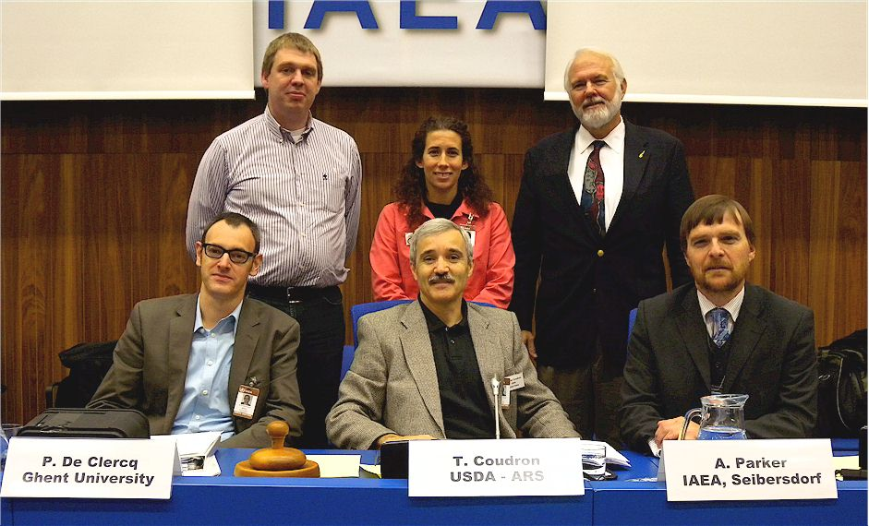
A BRIEF HISTORY OF THE GROUP
2010: 12th workshop of AMRQC in Vienna, Austria, in cooperation with IAEA. The group was renamed to "Mass Rearing and Quality Assurance (MRQA)" Working Group, to reflect its broadened scope
IOBC/MRQA

Slide 13
ACTIVITIES OF MRQA
Provide a global forum for scientists, practitioners and regulators to develop quality assurance procedures and quality control standards
Offer support and consultation for mass-reared invertebrates for IPM programs (biocontrol agents of pests and weeds, pollinators, SIT…), but also for those reared for research (e.g., testing of pesticide efficacy and side-effects) or production purposes (e.g., natural substances, baculovirus…)
Help develop and archive relevant literature
Promote harmonization of quality control guidelines developed for natural enemies
IOBC/MRQA

Slide 14
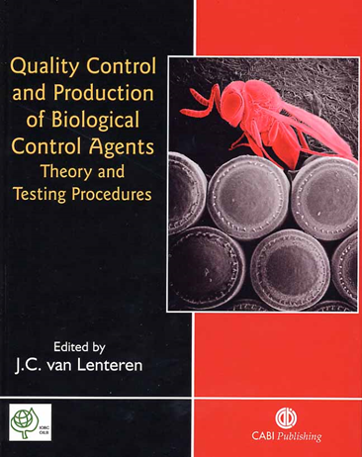
QC Guidelines
Joop van Lenteren (2003), IOBC- Guidelines for quality control of commercially produced natural enemies, 30 species
Rose Buitenhuis (2014), Grower guide to quality assurance of biocontrol products, 22 species
IOBC/MRQA

Slide 15
CLIENTELE OF MRQA
MRQA serves all individuals and institutions, both private and public, active in the field of mass rearing and quality assurance:
Insectary managers and others responsible for quality assurance (QA) in public and private organizations
Researchers of invertebrate production and QA techniques
Government officials responsible for regulating the use of invertebrates for biological and genetic control
Users of invertebrate products
Membership in the MRQA is free (currently ca. 100 members in the mailing list), but colleagues are encouraged to join IOBC
IOBC/MRQA

Slide 16
MRQA Workshops
1982-2010: 12 workshops, alternately organized in Europe and the Americas
2013: first workshop in Asia
Forums for determining the status of invertebrate production and recommending a course of action for the future
Networking and collaboration
IOBC/MRQA

Slide 17
Workshops of the IOBC, WGQC (AMRQC, MRQA)
1982 Gainesville, Florida E. F. Boller and D. L. Chambers
1984 Wadenswil, Switzerland E. F. Boller and D. L. Chambers
1986 Guatemala City, Guatemala C. 0. Calkins
1988 Vancouver, Canada C. 0. Calkins
1991 Wageningen, Netherlands F. Bigler and J. C. van Lenteren
1992 Horsholm, Denmark F. Bigler
1993 Rimini, Italy M. Benuzzi and N. C. Leppla
1995 Santa Barbara, California R. F. Luck and N. C. Leppla
1998 Cali, Colombia N. C. Leppla and T. R. Ashley
2003 Montpellier, France P. De Clercq, S. Grenier and NCL
2007 Montreal, Canada S. Grenier and C. S. Glenister
2010 Vienna, Austria P. De Clercq and T. A. Coudron
2013 Bangalore, India P. De Clercq and T. A. Coudron
2017 Merida, Mexico P. De Clercq and T. A. Coudron
IOBC/MRQA

Slide 18
MRQA Website
IOBC/MRQA

Slide 19
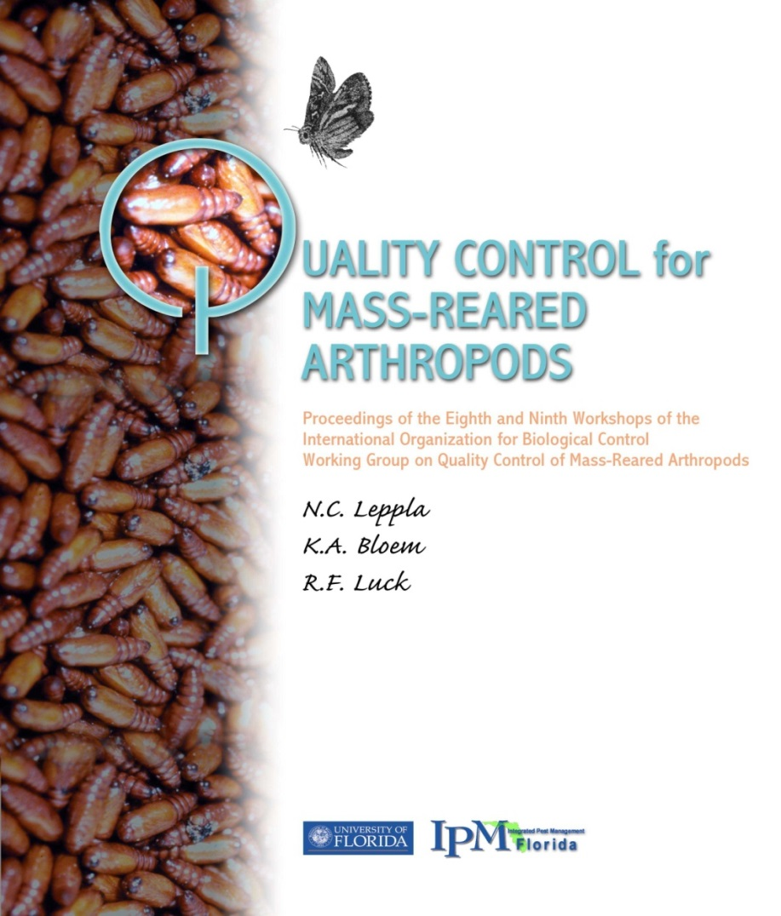
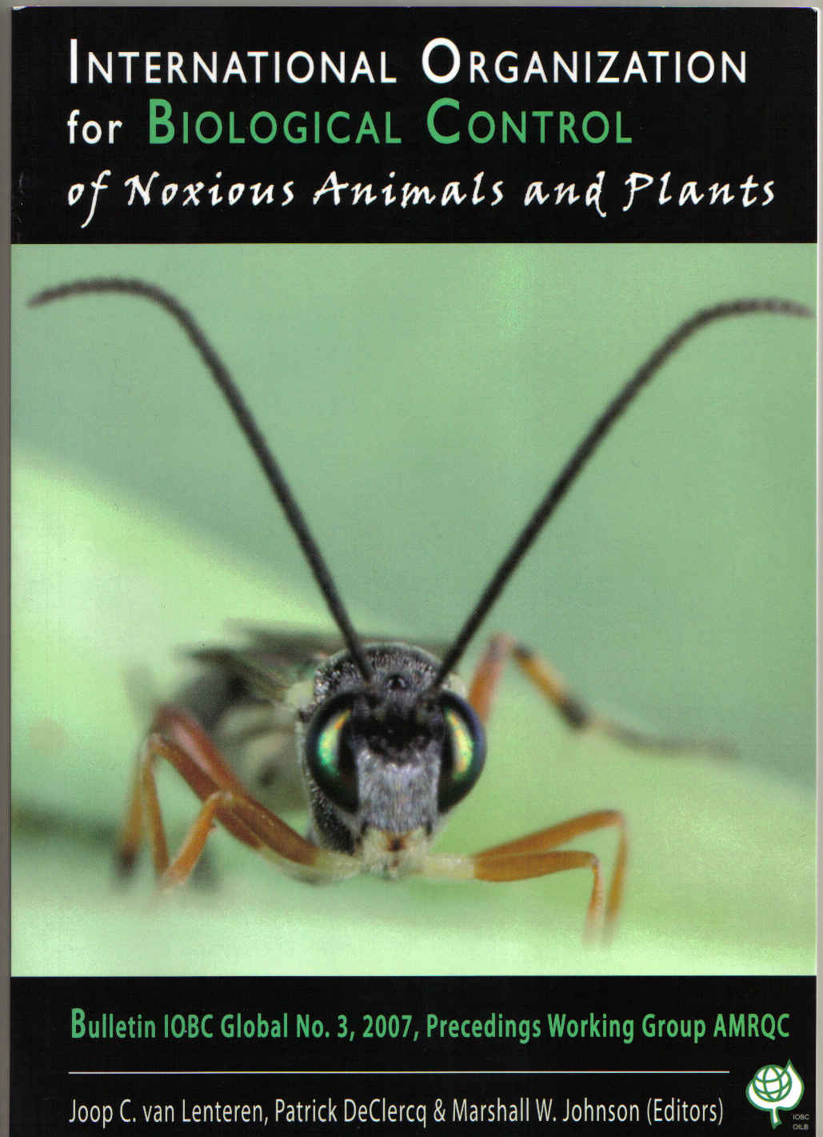
Proceedings of 8^{th/}9th and 11th Workshops
IOBC/MRQA

Slide 20
MRQA Website
Roots and traditions of the working group- Leppla & De Clercq
WGQC/AMRQC proceedings, FRASS newsletters (1975-1996), and other relevant publications
Announcements of workshops, upcoming activities and new publications
Membership application (free)
Website: www.amrqc.org
IOBC/MRQA

Slide 21
FUTURE CHALLENGES
MRQA will continue to promote invertebrate production systems based on 3 essential components: reliability, cost effectiveness, and quality
MRQA will interact with researchers, and biocontrol producers’ associations, including the International Biocontrol Manufacturers' Association (IBMA), Association of Natural Biocontrol Producers (ANBP) and producers in emerging markets in Asia, South America…
MRQA will continue to build links with producers of invertebrates for other purposes (e.g. for human and animal food, medical purposes, waste bioconversion…) but its core business remains related to IPM
MRQA offers a forum for the further development and updating of quality control guidelines for invertebrate biological control agents
IOBC/MRQA

